Slide 1
Resilience Bounds of Sensing-Based Network Clock Synchronization
Rui Tan Linshan Jiang Arvind Easwaran Jothi Prasanna Shanmuga Sundaram
School of Computer Science and Engineering
Nanyang Technological University
The 24th IEEE International Conference on Parallel and Distributed Systems (ICPADS)
December 11, 2018, Sentosa, Singapore.

Slide 2
Outline
Background A bit long …
Problem Definition
Analysis & Results
Conclusion

Slide 3
Clock Synchronization
Roboteam
Industrial systems need accurate clock sync
ms or even μs accuracy
Desynchronization
Degrade system performance
Cause infrastructure damage
Notes:
Now, I will present a recent work on using physical fingerprints for secure clock synchronization. Clock synchronization is a very basic system function. For example, many industrial systems such as power grids and manufacturing systems need accurate clock synchronization up to millisecond or even microsecond accuracy. The desynchronization will degrade system performance and even cause infrastructure damage. For example, this video shows a roboteam in a manufacturing system. We can see that they are highly coordinated. This coordination is driven by their synchronized clocks. If they are desynchronized, these robotic arms will clash with each other, causing equipment damages.

Slide 4
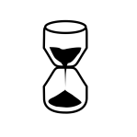
Clock Sync Security
GPS
Not scalable, vulnerable to wireless spoofing
Message exchange based protocols (NTP, PTP, …)
Vulnerable to packet delay attack [RFC 7384] Implemented in wired/wireless networks
No pure cryptographic solution
master
t₂
t₃
Symmetric link assumption
clock
slave
t₁
t₄
t₄’
clock
Notes:
GPS and various protocols are two major approaches to clock synchronization.
GPS can provide accurate time information. However, using GPS is not scalable and it does not work in indoor environment. And it is susceptible to wireless spoofing attacks.
NTP and PTP are examples of clock sync protocols. NTP is widely used in Internet and PTP is often used in mission-critical systems. Most protocols are based on this two-way communication principle. Specifically, the slave will record its clock values when it transmits the request and receives the reply. The master node also record its clock values when it receives the transmits the two packets. Then, based on an assumption that the two one-way transmission delays are the same, we can compute the clock offset between the slave and master nodes. And this offset is further used to update the clock of the slave. However, this principle is vulnerable to a simple but basic packet delay attack that breaks the symmetric link assumption. For example, if the attacker can delay the reply packet for a certain time duration, then the introduced error to the clock offset computation is half of the introduced delay. And this vulnerability has no pure cryptographic solution.

Slide 5
Secure Sensing-Based Clock Sync
master
T
clock
slave
clock
Common periodic impulses from physical ambient
Synchronous: Impulses occur at the same time
Securely synchronizable: Correspondence between two impulses w/o measuring network delays

Slide 6
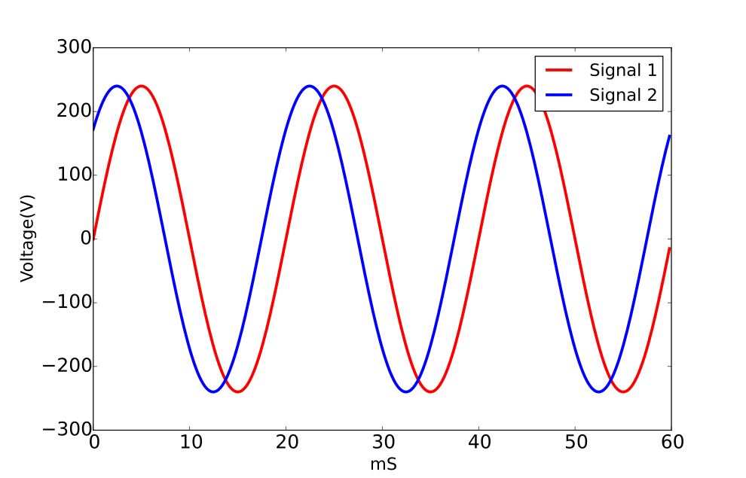
Electric Network Voltage (ENV)
?
Synchronous
100 μs offset over 10 km
Hard to compromise
Inject large energy to distort 50Hz ENV
Modify power network
Securely synchronizable?
Notes:
To address the packet delay attack, we leverage the electric network voltage signal. We know that all power grids are alternating current power grids, and the voltage is a sine wave. Moreover, from power engineering, the voltage signals at different locations in an area, for example, a building or even up to a city, are highly synchronized. This figure illustrates the voltage signals at two locations with a phase shift. From our measurements in Singapore, this phase shift is just 0.2ms over 10 km distance. Moreover, power grid voltage is hard to compromise, unless the attacker launches physical attacks against the power grid infrastructures.

Slide 7
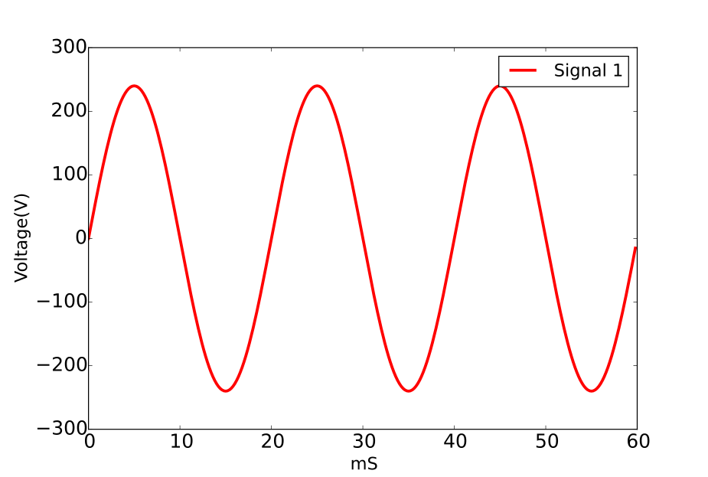
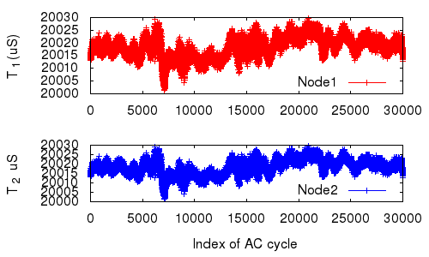
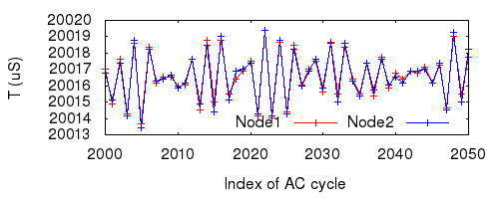
Time Fingerprint (TiF)
T
TiF: a sequence of cycle lengths
TiF form fluctuates randomly
Nodes in an area observe similar forms
Notes:
In this work, we explore a time fingerprint from the power grid voltage. We measure the cycle length of the voltage signal, which is illustrated in the top figure. A time fingerprint is a series of consecutive cycle lengths. The bottom left figure shows the traces of the cycle lengths captured by two nodes at two different places, and the right figure shows a zoom-in version. We can see that the fluctuations are kind of random and the fluctuations experienced by the two nodes are almost the same. So, we make two assumptions: first, we assume that the signal form does not repeat over a certain time period; second, nodes in an area observe similar signal forms. If the first is true, the signal form self-explains when the signal is captured; if the second is true, we can use it to synchronize two nodes, just by matching their signals. In fact, these two assumptions stem from a key property of power grid frequency – the power grid frequency is a random process, although it is regulated at 50Hz in Singapore for example, and the frequencies at any two locations in a power grid are very similar at the same time instant. Later, we will verify these two assumptions by measurements.

Slide 8
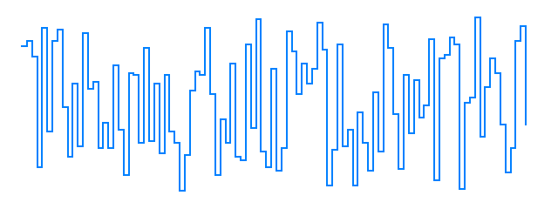


Secure Sync via TiF Matching
Node A’s TiF trace
voltage cycle length
Timestamp of Node B’s TiF
in terms of Node A’s clock
Node A’s clock time
Rare matching errors
With sufficiently long TiF, empirical prob. = 1
Resulting sync error is nT

Slide 9






Our Previous Studies
S. Viswanathan, R. Tan, D. Yau, Exploiting Power Grid for Accurate and Secure Clock Synchronization in Industrial IoT, RTSS’16.
S. Viswanathan, R. Tan, D. Yau, Exploiting Electrical Grid for Accurate and Secure Clock Synchronization, ACM TOSN, Jul 2018.
Non-malicious matching errors
Grid-connected devices
Clock sync insecurity caused by delay attack
Y. Li, R. Tan, D. Yau, Natural Timestamping Using Powerline Electromagnetic Radiation, IPSN’17 (best paper).
Y. Li, R. Tan, D. Yau, Natural Timestamps in Powerline Electromagnetic Radiation, ACM TOSN, Jul 2018.
Wireless IoT sensors
Z. Yan, Y. Li, R. Tan, J. Huang, Application-Layer Clock Synchronization for Wearables Using Skin Electric Potentials Induced by Powerline Radiation, SenSys’17.
Z. Yan, R. Tan, Y. Li, J. Huang, Wearables Clock Synchronization Using Skin Electric Potentials, IEEE TMC, in press.
Time-critical wearables

Slide 10
Outline
Background
Problem Definition
Analysis & Results
Conclusion

Slide 11
Network Clock Sync Model
N-node system
Constant clock offset between n_{i} and n_{j}
n₀
n₁
P2P clock sync may be faulty
n₂
n₃
if the sync between n_{i} and n_{j} is faulty
A P2P clock
sync session
otherwise
Clock offsets estimation equation system
with sync faults considered

Slide 12
Sync Fault vs. Byzantine Clock Fault
Byzantine faulty clock [Lamport et al. in 1980s]
A faulty clock always gives an arbitrary clock value whenever being read
In a (3m+1)-node system with m faulty clocks, non-faulty clocks can remain synchronized
In this work, a node involved in a faulty sync session is not a Byzantine faulty clock
n₀
n₁
n₀
n₁
n₂
n₃
n₂
n₃
Byzantine clock fault
Sync fault

Slide 13
Fault-Tolerant Network Clock Sync
Algorithm 1: Faulty-tolerant network clock sync algorithm
Given: All P2P clock offset measurements Output: Estimated P2P clock offsets and sync faults 1: for k = 0 to k = N(N-1)/2 do 2: for each distribution of the k assumed P2P sync faults among the N(N-1)/2 P2P sync sessions do 3: if the corresponding equation system has a solution then 4: return the estimated clock offsets and sync faults 5: end if 6: end for 7: end for
n₀
n₁
n₂
n₃
A 4-node system with a distribution of the k=2 assumed sync faults
Discrete sync errors enable this
Requires neither the # nor the distribution of the actual P2P sync faults
How many sync faults Algorithm 1 can tolerate?

Slide 14
Q-Resilience
A N-node system is Q-resilient if Algorithm 1 can correct any Q P2P sync faults.
Q-resilience condition
For any k ∈ [0, Q), the equation system with any distribution of the Q actual faults (d_{Q}) and any distribution of the k assumed faults (d_{k}) has no solutions;
When k = Q, for any d_{Q} and any d_{k}
If d_{Q} = d_{k}, the equation system has a unique solution*
Otherwise, the equation system has no solutions.
* This unique solution must be correct.

Slide 15
Resilience Bounds
f_{l}(N) is a lower bound of the maximum resilience if any N-node network with Algorithm 1 is Q-resilient for Q ≤ f_{l}(N).
f_{u}(N) is an upper bound of the maximum resilience if any N-node network with Algorithm 1 is not Q-resilient for Q > f_{u}(N).

Slide 16
Outline
Background
Problem Definition
Analysis & Results
Conclusion

Slide 17
Analysis Approach
The equation system used for estimating clock offsets and sync faults
The equation system used for analyzing Q-resilience

Slide 18
Resilience of Certain Cases
By enumerating counterexamples:
n₀
n₁
n₀
n₀
n₁
n₃
n₁
n₂
n₂
n₃
n₂
n₃
N = 3
N = 4
N = 5
Not 1-resilient
1-resilient
Not 2-resilient
1-resilient
Not 2-resilient
Results for general N-node systems?

Slide 19
Main Challenge and Approach
Values of actual sync faults matter!
E.g., when k < Q, if actual sync faults satisfy certain condition, equation system may have (wrong) solutions
A pitfall in analyzing the general Q-resilience
The equation system used for analyzing Q-resilience for general N-node system
Consider actual sync faults as unknowns

Slide 20
Algorithm to Compute Lower Bound
Algorithm 2: Compute a lower bound of maximum resilience
Given: The number of nodes N Output: A lower bound of maximum resilience 1: for Q = 1 to Q = (N – 2) do 2: for each distribution of the Q actual P2P sync faults among the N(N-1)/2 P2P sync sessions do 3: for k = 0 to k = Q do 4: for each distribution of the k assumed faults among the N(N-1)/2 P2P sync sessions do 5: determine the value of l (i.e., the number of correctly positioned estimated faults) 6: if rank(A’) ≠ N – 1 + k + Q – l then 7: return Q – 1 8: end if 9: end for 10: end for 11: end for 12: end for
Refer to paper for the proof on why this algorithm computes a lower bound

Slide 21
Resilience Bounds
Computed lower bound of maximum resilience
Any N-node system is Q-resilient if Q ≤ f_{l}(N)
N | 4 | 5 | 6 | 7 | 8 | 9 | 10 | 11 | 12
f_{l}(N) | 1 | 1 | 2 | 2 | 2 | 3 | 4 | 5 | 5
(N – 2) is an upper bound of maximum resilience
Any N-node system is not Q-resilient if Q > (N – 2)

Slide 22
Conclusion & Future Work
Analyzed resilience of sensing-based network clock sync
An algorithm to compute a lower bound
An analytical upper bound
Future work
Tight bound
Reduce # of P2P sync sessions

